Slide 1
Data Structures and Algorithms – Lab 7
FILS, March 2018

Slide 2
Objectives
Studying the Linked List abstract data type(ADT) and its different variations
Implementing the Linked List: the basic methods
Using Linked Lists to implement stacks and queues

Slide 3
Generalities
A list is an instance of an ADT that formalizes the concept of ordered collection of entities.
At least, a list is characterized by the following operations:
Add – adds an element (entity) to the list: at the beginning, at the end or at an arbitrary position
Remove – removes an element (entity) from the beginning/end of the list or taken into account its index/content
Get – consults an element taken into account its index
Update – updated the information/content of an element
A list has the following properties:
The length – the nr of elements in the list (in a function GetSize())
The type – the type of elements in the list

Slide 4
Implementations
Using list data structures (singly linked lists or doubly linked lists): each node contains the information and the link to its neighbors (doubly linked lists) or to the next element in the list (singly linked lists ); the nodes are allocated dynamically, as they are need, so, practically, we can obtain lists of a size limited only by the program memory;
Using dynamic arrays: lists are stocked in vectors; if, when adding a new element, the size of the array is exceeded, the arrays is reallocated; this implementation has the advantage of increased access speed (elements are in successive memory locations), but is limited by the amount of contiguous memory available to the program;

Slide 5
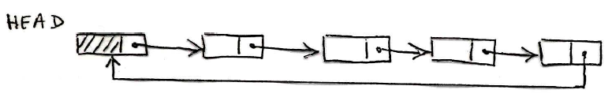
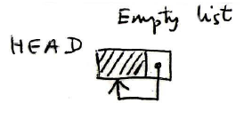
Types of Linked Lists (1)
Singly-linked linear lists
Singly-linked circular lists

Slide 6

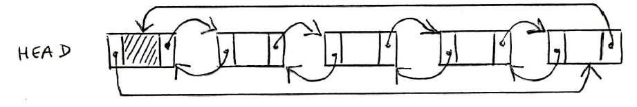
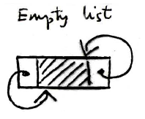
Types of Linked Lists (2)
Doubly-linked linear lists
Doubly-linked circular lists

Slide 7
Exercises
1. Test the double-linked list from the course and based on it implement a double-linked circular list.
2. Implementing a queue using lists.
3. Implement a singly-linked linear list. Attention: a new node will contain only the information and the address to the next node.
4. Test the implementation from Ex. 3 by implementing a stack using lists.

Slide 8
5. Add to it the following methods:
Delete its first element;
Delete its last element.
Beware of null elements!
6. Considering the linked list, make two lists such that the first one to contain only the odd numbers which appear in the initial list and the second one to contain the even numbers of it. Display the two new lists.

Slide 9

All the exercises which are not finished in class remain as homework!

